Slide 1
Slater determinant, Restricted/Unrestricted orbital, Self-consistent field (SCF), Hartree-Fock theory, Density Functional Theory
Instructor: Prof. Tzuhsiung (Nick) Yang
Email: tyang@mx.nthu.edu.tw
Time: M5/6
Room: NTHU Library Comp Lab II
Notes:
Rafael Gomez

Slide 2
Suggested reading
Chapter 2 and 3 in Szabo, A.; Ostlund, N. S. Modern Quantum Chemistry: Introduction to Advanced Electronic Structure Theory; Courier Corporation, 2012.

Slide 3
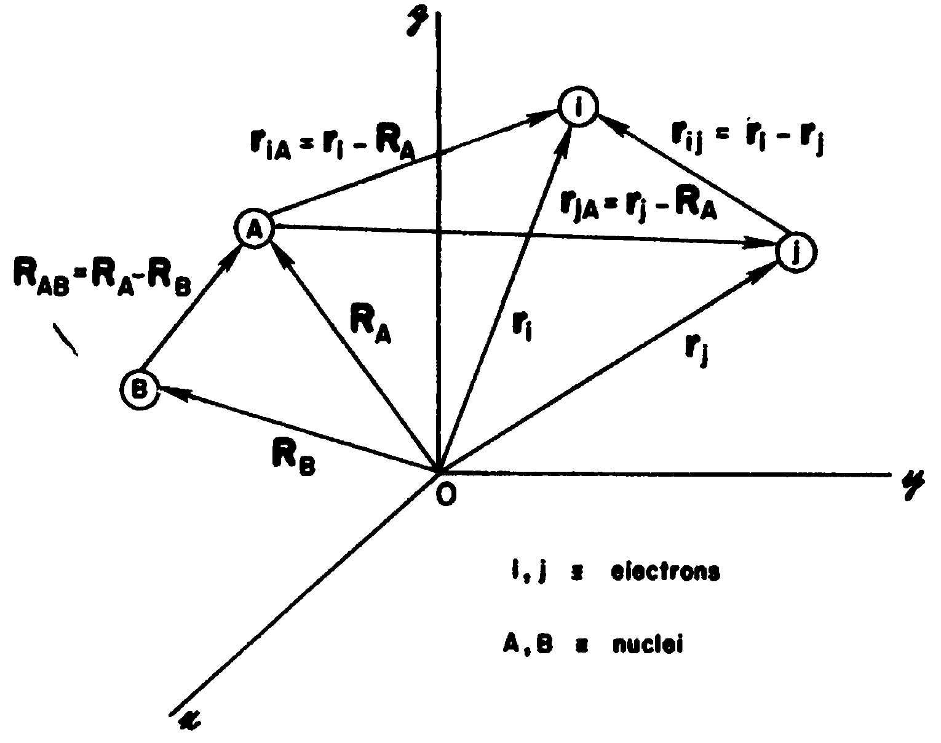
Atomic units

Slide 4
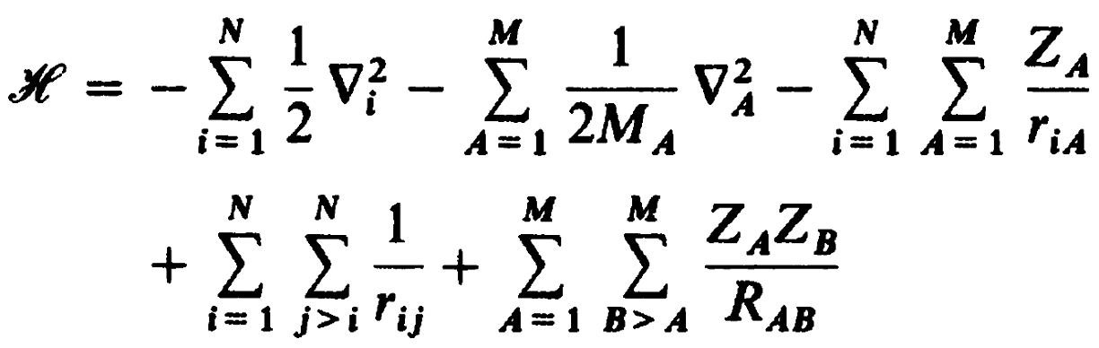
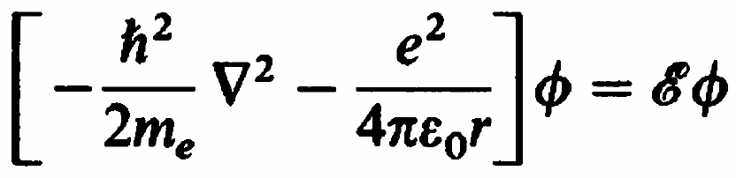
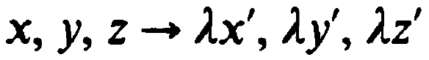
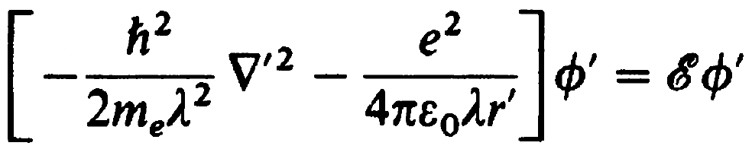
Atomic units
Schrodinger equation (SE)
In this equation, we use atomic units.
is transformed by

Slide 5
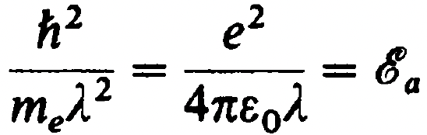
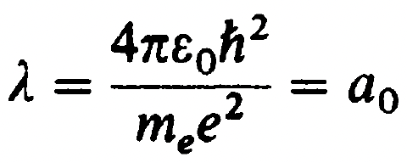
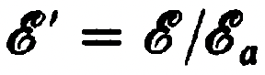
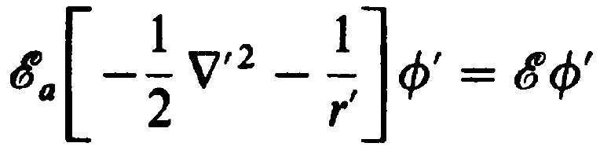
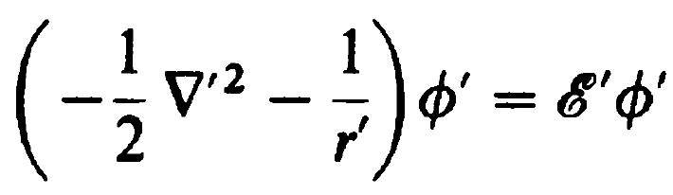
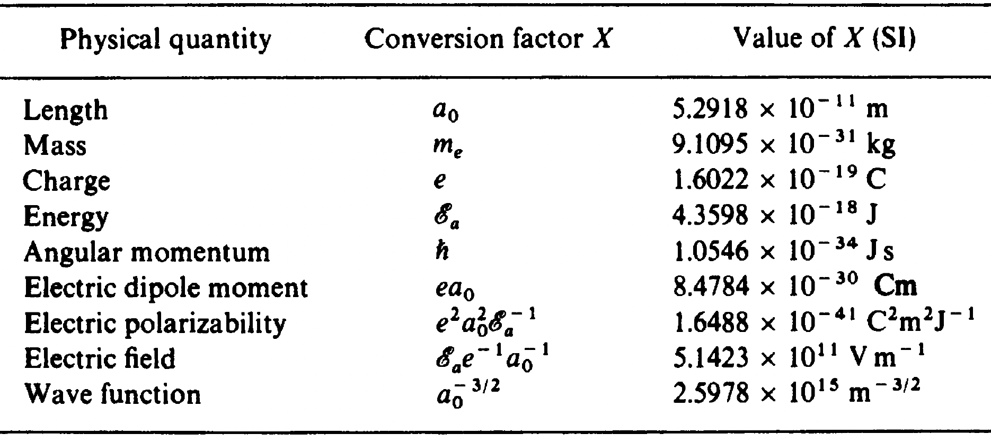


Atomic units
Set the coefficients to equal
$$⇒$$
Factor out and scale by
$$⇒$$

Slide 6
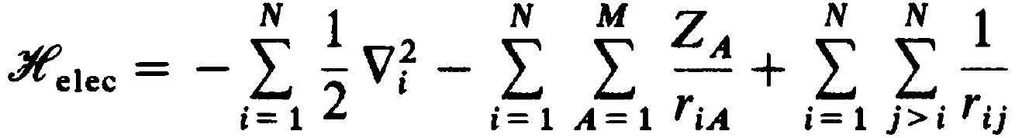
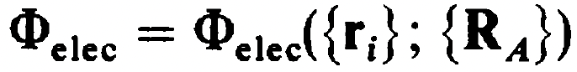
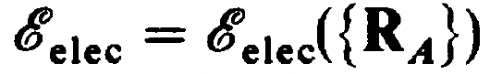

Born-Oppenheimer Approx.
Schrodinger equation
can be separated into the electronic and nuclear parts:
$$⇒$$
which is solved iteratively for a many electron system in the mean-field approximation using the self-consistent field (SCF) method (to be discussed).

Slide 7
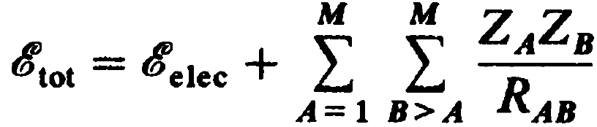
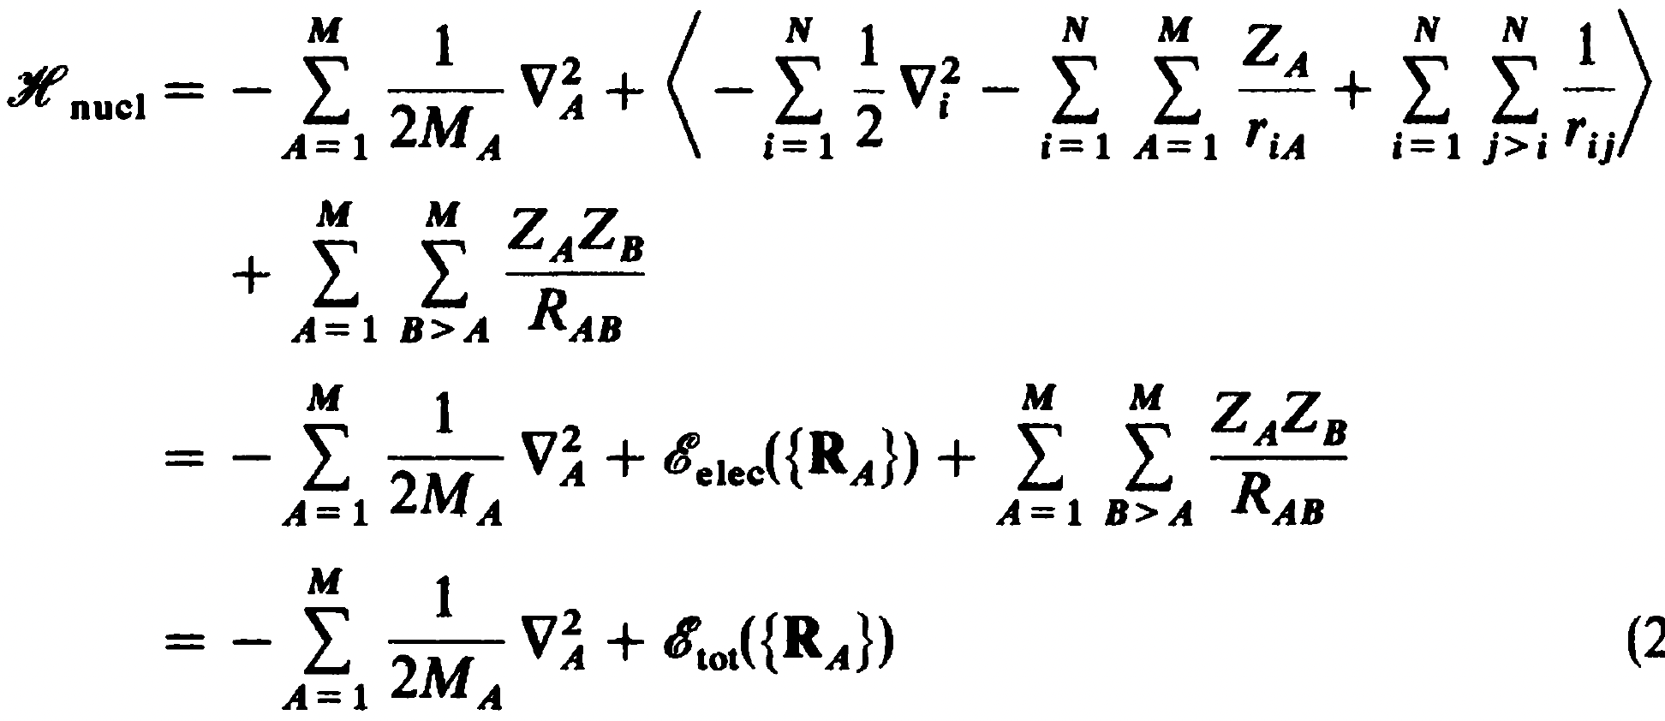
Born-Oppenheimer Approx.
The total energy at a given set of nuclear coordinates is
And the corresponding nuclear equation is

Slide 8
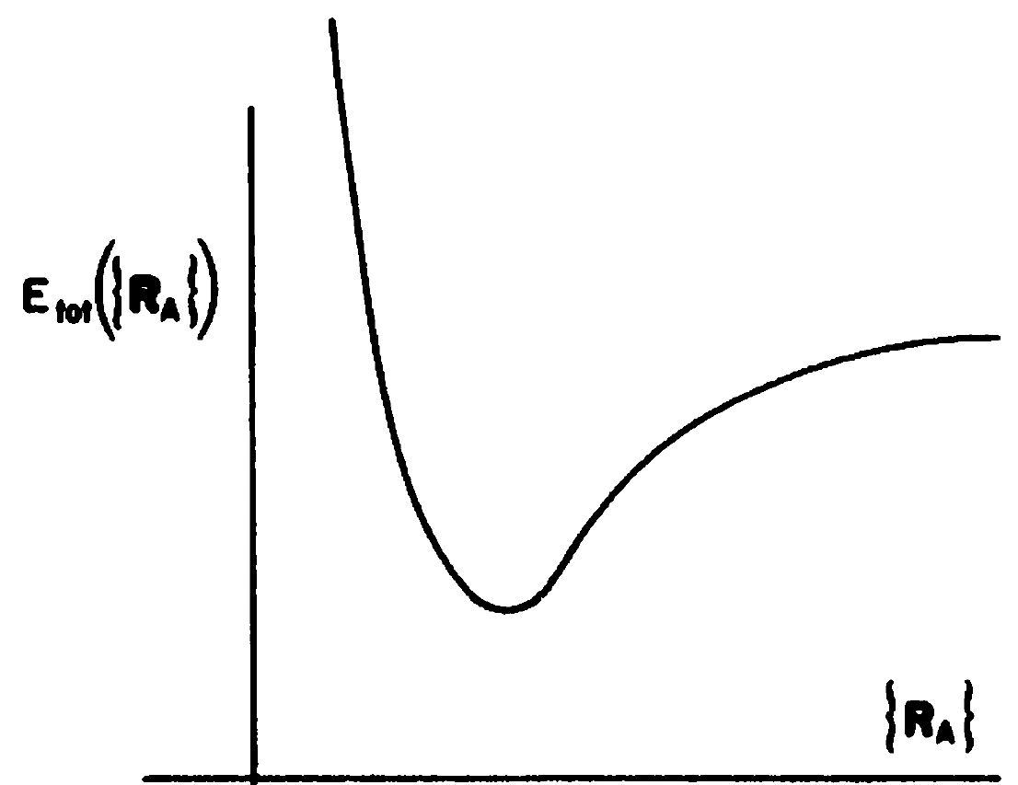
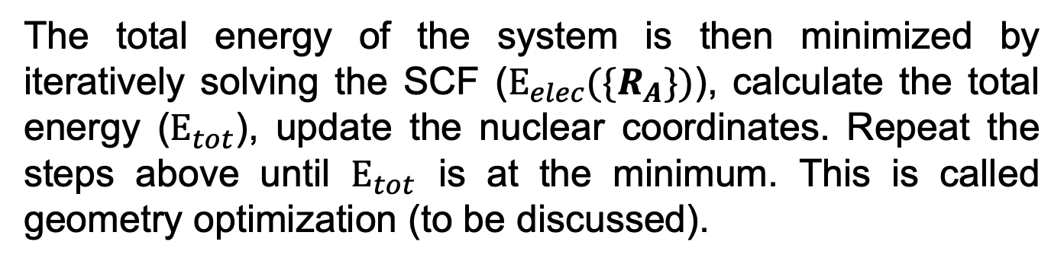
Born-Oppenheimer Approx.
The total energy of the system is then minimized by iteratively solving the SCF ($Ε_{elec}(\{R_{A}\})$), calculate the total energy ($Ε_{tot}$), update the nuclear coordinates. Repeat the steps above until $Ε_{tot}$ is at the minimum. This is called geometry optimization (to be discussed).

Slide 9
Interactive
Now, we will perform two interactive tasks: 1) solve the Schrodinger for fixed nuclear coordinates and 2) iteratively optimize the nuclear coordinates after each convergence of the electronic wavefunction. For this exercise, we will be using PySCF, a QC software written in Python by the group of Garnet Chan at Caltech. PySCF gives us full control over the components in the SE.

Slide 10
Interactive
Log into Taiwania1 on Vscode on MobaXterm
. ~/anaconda3/etc/profile.d/conda.sh (export the path to conda. The dot in the beginning is essential)
conda activate compchem (activate environment)
vi ~/anaconda3/envs/chem/lib/python3.9/site-packages/pyscf/lib/misc.py
change ‘a’ to ‘r’ on line 46
:46
i (go into insert mode)
Use your arrow to go behind a then backspace
Type r
Esc then :wq

Slide 11
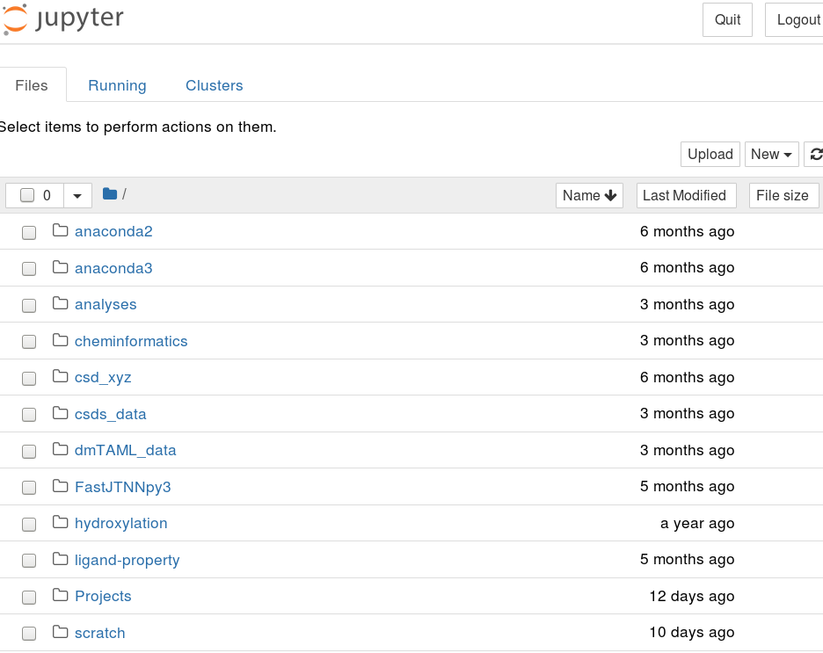
Interactive
Type jupyter notebook
A web browser should pop up

Slide 12
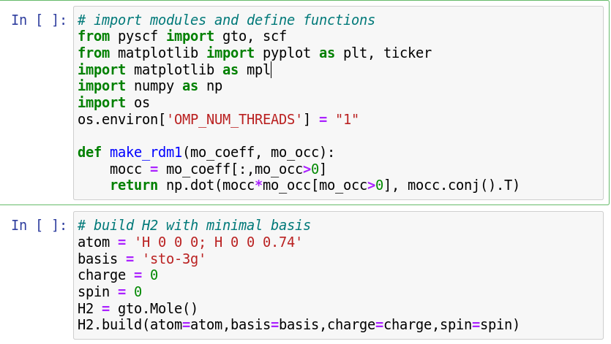
Interactive
Navigate through CompChem/Practice/Week1/Exercise1
Open scf.ipynb
Get the required libraries
Define a function to calculate the density matrix (DM, to be discussed)
User 1 core
Build a ¹H₂ molecule with the minimal basis set STO-3G (to be discussed)

Slide 13
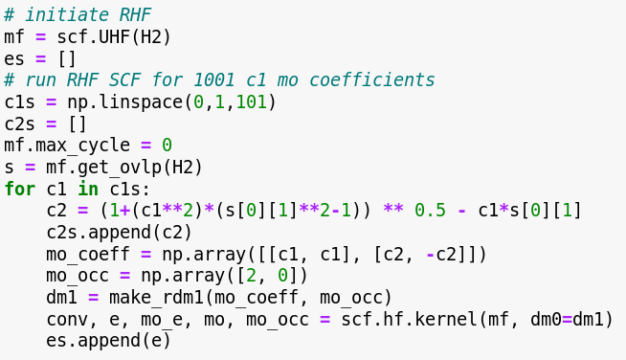
Interactive
Navigate through CompChem/Practice/Week1/Exercise1
Open scf.ipynb
Initiate a Hartree Fock calculation
Create a list to store the calculated energies
Define a list of 101 numbers equally spaced between 0 and 1
Create a list to store MO coefficients c₂

Slide 14
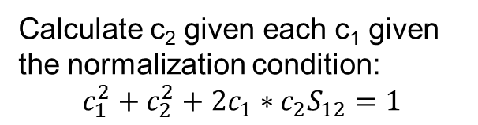
Interactive
Ask the program to only calculate the energy at a given DM
Calculate the overlap matrix between the basis sets
Calculate c₂ given each c₁ given the normalization condition:
$$c_{1}^{2}+c_{2}^{2}+2c_{1}∗c_{2}S_{12}=1$$
Calculate E

Slide 15
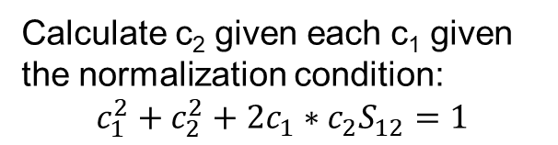
Interactive
Ask the program to only calculate the energy at a given DM
Calculate the overlap matrix between the basis sets
Calculate c₂ given each c₁ given the normalization condition:
$$c_{1}^{2}+c_{2}^{2}+2c_{1}∗c_{2}S_{12}=1$$
Calculate E

Slide 16
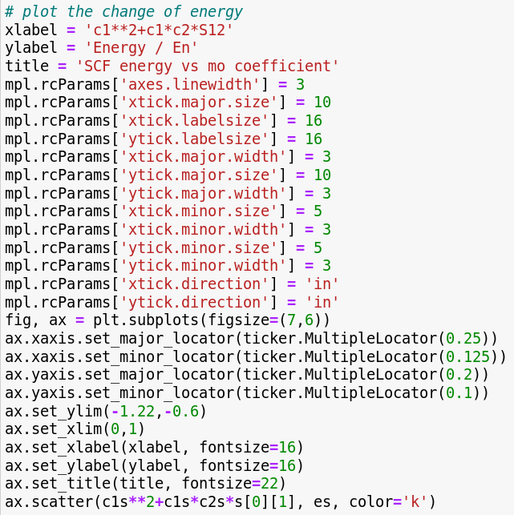
Interactive
Make a plot of
E vs c₁+c₁*c₂*S₁₂

Slide 17
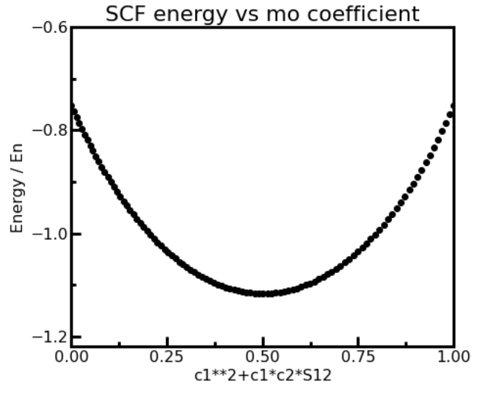
Interactive

Slide 18
Interactive
Navigate through CompChem/Practice/Week1/Exercise1
Open geom.ipynb

Slide 19
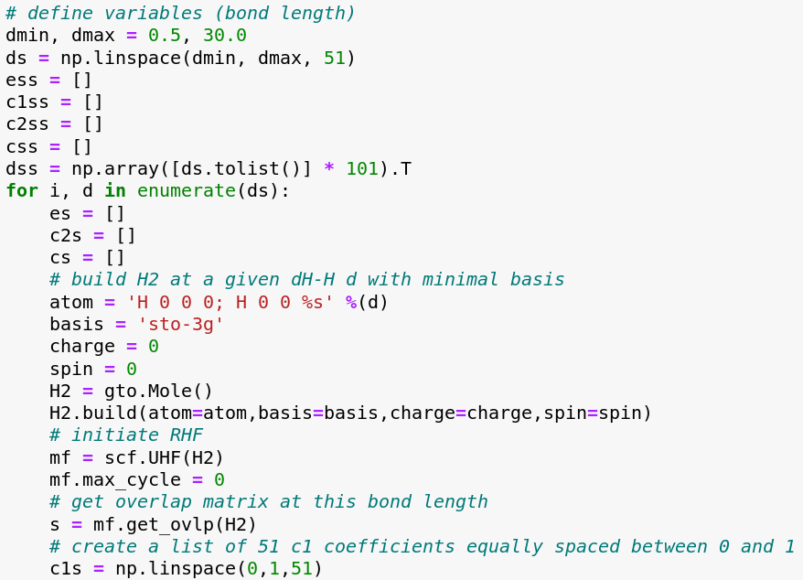
Interactive

Slide 20
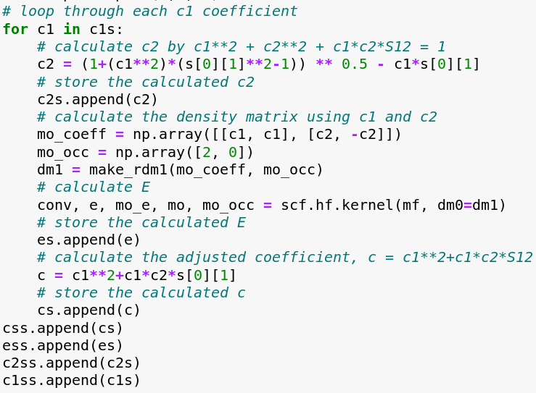
Interactive

Slide 21
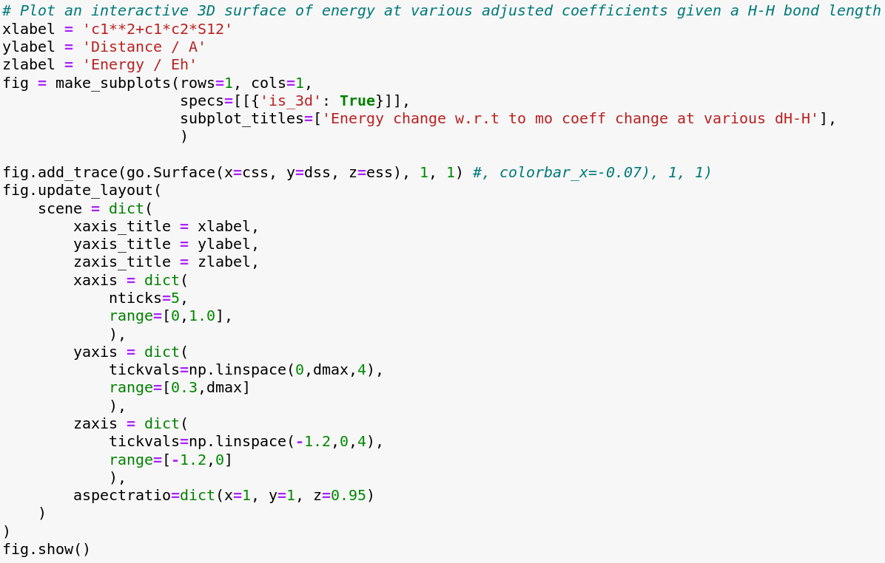
Interactive

Slide 22
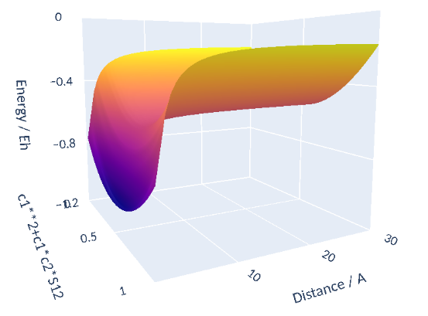
Interactive

Slide 23
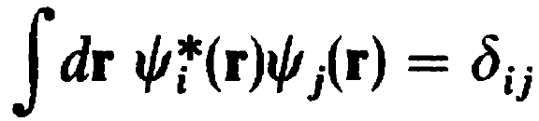
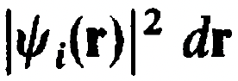
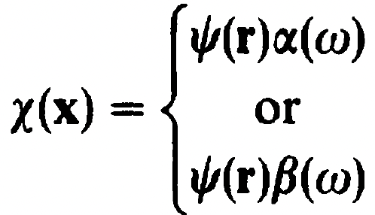
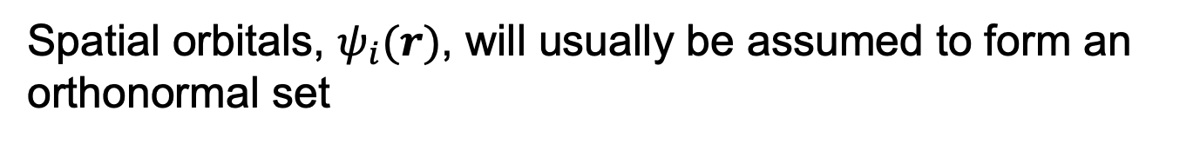
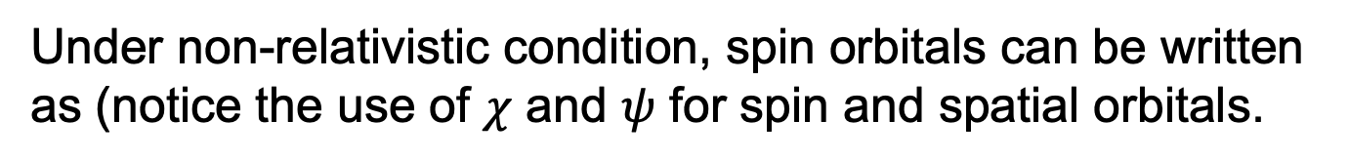
Orbitals
Spatial orbitals, $ψ_{i}(r)$, will usually be assumed to form an orthonormal set
with the probability of finding the electron being
Under non-relativistic condition, spin orbitals can be written as (notice the use of $χ$ and $ψ$ for spin and spatial orbitals.

Slide 24
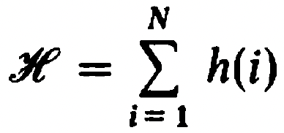
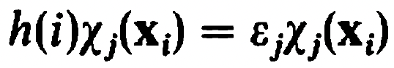

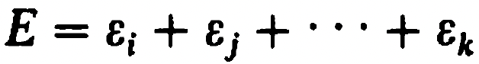
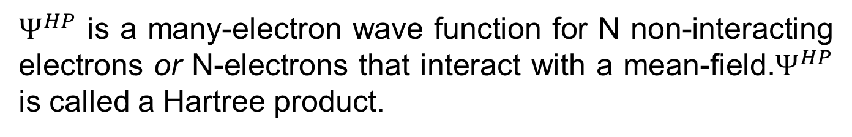
Slater determinants
Let’s consider a special scenario where electrons don’t interact
,
The corresponding eigenvalue problem is reduced to
with the eigenfunction (wave function)
and the eigenvalue
$Ψ^{HP}$ is a many-electron wave function for N non-interacting electrons or N-electrons that interact with a mean-field.$Ψ^{HP}$ is called a Hartree product.

Slide 25
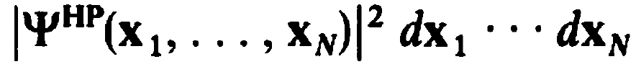
Slater determinants
Issues with the Hartree product
Electrons are indistinguishable
The wave function should be anti-symmetric with respect to the exchange of the space and spin of two electrons
Electrons are not correlated,
=

Slide 26
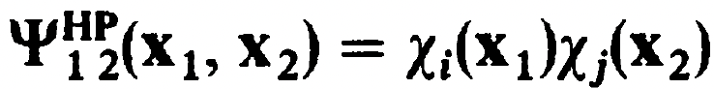
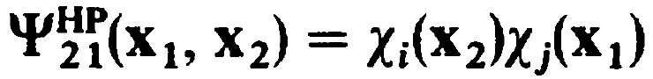
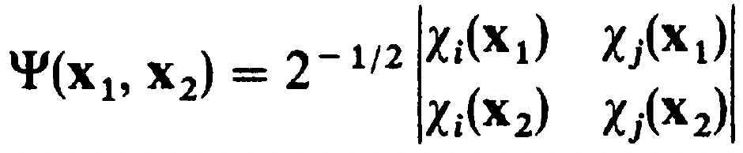
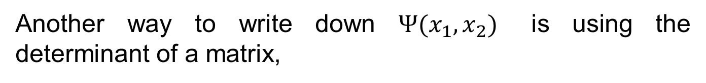
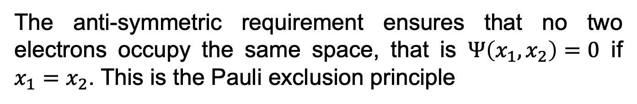
Slater determinants
One way to solve this problem is to write down all possible arrangements of the electrons in the orbitals
and form anti-symmetric combination of them
The anti-symmetric requirement ensures that no two electrons occupy the same space, that is $Ψ\left(x_{1},x_{2}\right)=0$ if $x_{1}=x_{2}$. This is the Pauli exclusion principle
Another way to write down $Ψ(x_{1},x_{2})$ is using the determinant of a matrix,

Slide 27
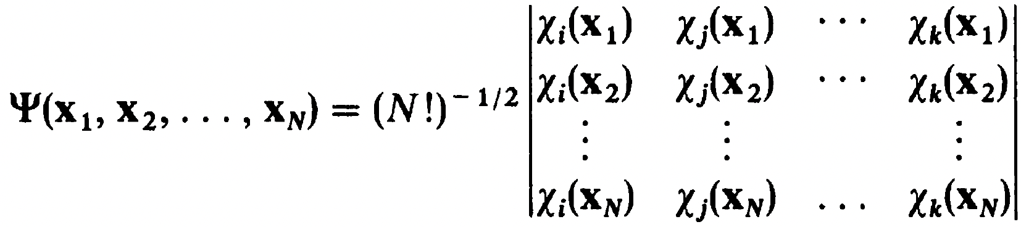
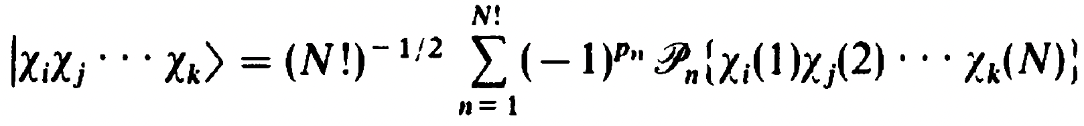
Slater determinants
Generally,
A Slater determinant can be short-handed as
which is

Slide 28
Slater determinants
Slater determinants solve the issues
Electrons are indistinguishable
The wave function should be anti-symmetric with respect to the exchange of the space and spin of two electrons
Electrons with parallel spins are correlated (exchange correlation)
Electrons with opposite spins are still not correlated

Slide 29
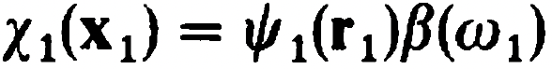
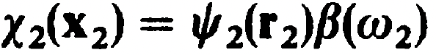
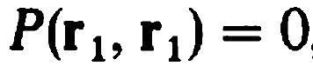
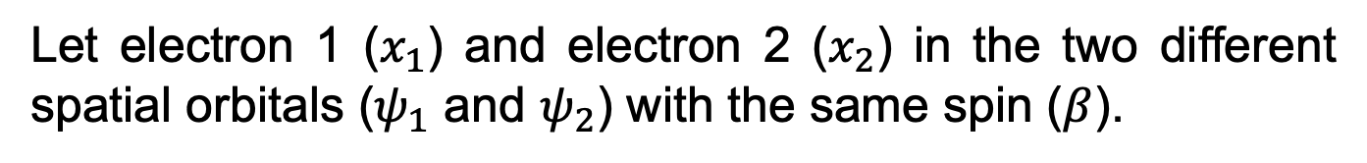

Slater determinants
Slater determinants solve the issues
Electrons with parallel spins are correlated
Let electron 1 ($x_{1}$) and electron 2 ($x_{2}$) in the two different spatial orbitals ($ψ_{1}$ and $ψ_{2}$) with the same spin ($β$).
,
The probability is
Let $ψ_{1}=ψ_{2}$,
cross terms cancel out self terms
$⇒$ there is no probability of finding two electrons in the same spot with the same spin, which is the the exchange correlation. A Fermi hole is said to exist around an electron.

Slide 30





Slater determinants
Slater determinants still have the issue
Electrons with opposite spins are still not correlated
Let electron 1 ($x_{1}$) and electron 2 ($x_{2}$) in the two different spatial orbitals ($ψ_{1}$ and $ψ_{2}$) with opposite spins ($α$ and $β$).
,
The probability is
Cross terms vanish as $\left\langle α(w_{i}) | β(w_{i})\right\rangle =0$
Let $ψ_{1}=ψ_{2}$
$⇒$ there is finite probability of finding two electrons in the same spot, which is not physical, due to the lack of electron correlations for opposite spins.

Slide 31
Interactive
As a consequence of the lack of electron correlation for electrons with opposite spins, mean field methods based on the Slater determinants will under-stabilize lower spin states, e.g. vertical gap between the triplet excited state and the ground state is underestimated because S₀ is not as stable as it should be.
To show this, we will investigate the energy difference between the singlet and triplet states of ethylene at the equilibrium geometry of the singlet ground state. Experimental value for the vertical excitation is 100.5 kcal/mol.

Slide 32

Interactive
Navigate through CompChem/Practice/Week1/Exercise2
Open triplet_gap.ipynb

Slide 33

Interactive

Slide 34

Interactive
SCF gap is 76.36
CCST(T) gap is 104.14
Singlet state energy was corrected from the UHF reference by -201.03
Triplet state energy was corrected from the UHF reference by -173.25

Slide 35






Spin-adapted Configurations
Let’s consider the spin angular momentum operators
,
The total squared magnitude of the spin is
Since the Hamiltonian commutes with ${\hat{S}}_{z}$ and ${\hat{S}}^{2}$
The exact wave function is an eigenfunction of ${\hat{S}}_{z}$ and ${\hat{S}}^{2}$
,
Hence, the eigenvalue of the ${\hat{S}}_{z}$ of the exact wave function is

Slide 36

Spin-adapted Configurations
There are three types of determinants:
Close-shell (Restricted) determinants
Open-shell restricted determinants
Open-shell unrestricted determinants
Let’s consider the case of two-electron in four spin orbitals, such as Hartree Fock wave function with minimal basis H₂
There are $\left({4 \atop 2}\right)=6$ configurations
(a)
(b)
(c)
(d)
(e)
(f)
The case (a) is the Hartree Fock ground state wave function in the minimal basis H₂, which is a close-shell determinant.

Slide 37

Spin-adapted Configurations
(a)
(b)
(c)
(d)
(e)
(f)
The cases (b)-(e) are four singly excited determinants
The open-shell determinants (b) and (c) are eigenfunctions of ${\hat{S}}^{2}$ with eigenvalues of 2 and thus are both triplets:

Slide 38



Spin-adapted Configurations
(a)
(b)
(c)
(d)
(e)
(f)
For (d) and (e), let’s consider ${\hat{S}}_{−}{\hat{S}}_{+}\left|\left.1\overline{2}\right\rangle \right.$. By chain rule, the first operation will generate${\hat{S}}_{−}\left(0+\left|\left.12\right\rangle \right.\right)$ and the second operation will generate $\left|\left.\overline{1}2\right\rangle \right.+\left|\left.1\overline{2}\right\rangle \right.$. Therefore, the eigenfunction is a linear combination of (d) and (e).

Slide 39
Spin-adapted Configurations
(a)
(b)
(c)
(d)
(e)
(f)
Thus, the difference between an electronic configuration and a determinant is that a configuration can be multi-determinant.

Slide 40

Spin-adapted Configurations
(a)
(b)
(c)
(d)
(e)
(f)
The determinant (f) is just another close-shell determinant that represents the doubly excited wavefunction of the Hartree Fock ground state wavefunction of minimal basis H₂.

Slide 41





Unrestricted determinants
Let’s consider the ground state wavefunction of Li
It can be seen that the $ψ_{2s}^{α}$ electron is “polarized” by the $ψ_{1s}^{α}$ due to exchange interaction. Therefore, it is better to describe open-shell systems with different spatial orbitals for $α$ and $β$ spins (an unrestricted determinant).
$$⇒$$

Slide 42





Unrestricted determinants
Unrestricted determinants are formed from spatial orbitals that are not necessarily orthogonal
As a result, unrestricted wave functions are not eigenfunctions of ${\hat{S}}^{2}$; the $\left\langle {\hat{S}}^{2}\right\rangle$ is always larger than the theoretical values.
This is because unrestricted determinants can be expanded as a superposition of the corresponding spin-pure state and the higher spin-pure states. For example,

Slide 43

Interactive

Slide 44


Interactive
Navigate through CompChem/Practice/Week1/Exercise3
Open spin_adapted_configurations.ipynb
UHF: allow $ψ_{1}^{α}≠ψ_{1}^{β}$ for open-shell systems
ROHF: force $ψ_{1}^{α}=ψ_{1}^{β}$ for open-shell systems
RHF: only works for closed-open systems

Slide 45


Interactive

Slide 46
Interactive

Slide 47

Interactive
Energy difference ($\hat{H}$)
The UHF energy is lower than the ROHF energy by -11.06 for O2_0_3
The UHF energy is lower than the RHF energy by -32.71 for O2_0_1
The UHF energy is lower than the ROHF energy by -32.71 for O2_0_1
The ROHF energy is lower than the RHF energy by -0.0 for O2_0_1

Slide 48

Interactive
Total angular momentum (${\hat{S}}^{2}$)
The <S²> value for UHF O2_0_3 is 2.03
The < S² > value for ROHF O2_0_3 is 2.00
The < S² > value for UHF O2_0_1 is 1.02
The < S² > value for ROHF O2_0_1 is 0.00
The < S² > value for RHF O2_0_1 is 0.00

Slide 49


Interactive
Orbital energy ($ε$)
³O₂ (UHF)
³O₂ (ROHF)
¹O₂ (ROHF)
¹O₂ (RHF)

Slide 50


Fock operator
Let’s recall the assumption of Hartree product
,
,
$Ψ^{HP}$ can be replaced with a Slater determinant to include the exchange effect
The requirement of same spatial orbitals for each $α$ and $β$ spins can be further relaxed by unrestricted formalism with the sacrifice of it being an eigenfunction of ${\hat{S}}^{2}$
The important constraint is that the Hamiltonian acts on N non-interacting electrons or N-electrons within a mean-field.

Slide 51



Fock operator
To find a Hamiltonian that will satisfy this constraint, let’s start with a Lagrange multiplier
where

Slide 52



Fock operator
In order for the Hamiltonian to act on N-electrons within a mean-field, the two-electron integrals are replaced with mean-field integrals (operators).
$$⇒$$
The first term ${\hat{J}}_{b}\left(1\right)$ is a local operator that describes the total averaged potential acting on $χ_{a}(1)$.
The second term ${\hat{K}}_{b}\left(1\right)$ is a non-local operator that describes the total averaged potential, formed by other electrons if they were smeared in the space of $χ_{b}^{∗}χ_{a}$, acting on electron one if it was in spin orbital $χ_{b}$.

Slide 53



Fock operator
With the mean-field approximation, we can write down the (pseudo)eigenvalue problem which gives orbital energies
The operator (Fock operator) can be further written as
because
This last equation that the coulomb and exchange interactions cancel each other out exactly at the one-electron limit may seem trivial. However, it is a very important physical constraint and it is one of the main errors in density functional theory (DFT) called self-interaction error. We shall come back to this when we discuss DFT.

Slide 54
Interactive
To show that the two electron coulombic interaction (J_{a}(1)) and the exchange interaction (K_{a}(1)) cancel each other at the one electron limit as a result of the Slater determinant, we will investigate the simplest case, H, using the minimal basis (STO-3G, to be discussed) and UHF with HF equation or UKS (KS = Kohn Sham orbitals, to be discussed) with the PBE functional.
We know the exact solution to the SE for H, which is -0.5 Eh. Run the jupyter notebook in Exercise4 and see which method yields a better solution and why?

Slide 55

Interactive
Navigate through CompChem/Practice/Week1/Exercise4
Open self-interaction-error.ipynb

Slide 56


Slide 57
Interactive
UHF
J11_a is 0.77 Eh
K11_a is 0.77 Eh
Self-interaction error is J11_a - K11_a, 0.000 Eh
UKS(PBE)
J11_a is 0.3873 Eh
E_xc is -0.3851 Eh
Self-interaction error is J11_a - K11_a, 0.0022 Eh

Slide 58





Hartree Fock theory
The sum of the eigenvalues from the Fock operator is
which is not the energy of the system
$$⇒$$
Let’s consider a closed-shell Slater determinant
The corresponding HF equation is

Slide 59



Hartree Fock theory
Multiplying on the left by $α^{∗}\left(w_{1}\right)$ and integrating over spin
Expand the integrand by the definition of the Fock operator
The coulomb and exchange operators can be combined using the permutation operator, ${\hat{P}}_{12}$
The mean-field, $\sum_{c}{\int{d{\overset{⃑}{x}}_{2}χ_{c}^{∗}\left({\overset{⃑}{x}}_{2}\right)}r_{12}^{−1}\left(1−{\hat{P}}_{12}\right)}χ_{c}\left({\overset{⃑}{x}}_{2}\right)$, sums over all other electrons c, each smears in the phase space $d{\overset{⃑}{x}}_{2}$. The phase space contains both the spatial ($dr_{2}$) and the spin ($dw_{2}$) parts.

Slide 60


Hartree Fock theory
Expand and group the mean-field by spin coordinates
Thus there is only half as much exchange interaction

Slide 61




Hartree Fock theory
The close-shell Fock operator that considers spin orthonormality is thus
$$≡$$
And the corresponding energy of the system is
where means integrate over spatial orbitals.

Slide 62






Roothaan equation
How do we find $ψ_{i}$: linear combination of basis functions (atomic orbitals)
The integrals on the right form the overlap matrix;
The integrals on the left form the Fock matrix

Slide 63



Roothaan equation
The Roothaan equation in a compact matrix form is thus
The expansion coefficients (MO coefficients) are
Molecular orbitals $ψ_{i}$ are formed by multiplying the basis functions $\left.\left|φ_{u}\right.\right\rangle$ to the right of C

Slide 64


Self-consistent field
Charge density is determined as
Density matrix is thus defined as

Slide 65


Self-consistent field
Fock operator written in terms of the density matrix
In the matrix form written, it is written as

Slide 66





Self-consistent field
The first term is called the core-Hamiltonian matrix
,
The first term of $H^{core}$ is the kinetic energy integrals
The second term of $H^{core}$ is the nuclear attraction integrals
Since basis functions are not changed during the SCF procedure (unlike the density matrices), these two integrals remain constant during the procedure.

Slide 67





Self-consistent field
The second term is the two electron (four index) integrals, which is updated iteratively throughout the SCF procedure
where

Slide 68

The SCF procedure

Slide 69



Hartree Fock theory
Let’s consider the HF energy of minimal basis H₂
Intuitively, two electrons each with kinetic energy and nuclear attraction energy $h_{11}$ plus one coulombic repulsion energy $J_{11}$.
By the HF equation,
$$E_{0}=2\sum_{a=1}^{1}{h_{aa}}+\sum_{a=1}^{1}{\sum_{b=1}^{1}{{2J}_{ab}−K_{ab}}}=2h_{11}+2J_{11}−K_{11}=2h_{11}+J_{11} ∵J_{11}=K_{11}$$

Slide 70



Hartree Fock theory
Let’s consider the HF orbital energy of minimal basis H₂
When we evaluate the orbital energies, we only need to consider it’s kinetic energy and nuclear attraction energy $h_{11}$ and a coulomb interaction $J_{11}$

Slide 71



Hartree Fock theory
Let’s consider the HF orbital energy of minimal basis H₂⁻
When we evaluate the orbital energies, we only need to consider it’s kinetic energy and nuclear attraction energy $h_{22}$, two coulomb interaction $J_{12}$, and one exchange interaction $K_{12}$

Slide 72





Koopman’s theorem
So we just showed that the sum of the eigenvalues from the Fock operator is not the total energy of the system because it double counts the two-electron integrals. Why do we bother with the orbital energies then?
Let’s consider the Slater determinant with one electron removed under a frozen orbital approximation
, ${\hat{a}}_{c}$ is the annihilation operator
The corresponding ionization potential is

Slide 73


Koopman’s theorem
, ${\hat{a}}_{c}$ is the annihilation operator

Slide 74





Koopman’s theorem
Similar result holds for electron affinity

Slide 75

Koopman’s theorem
Issues with Koopman’s theorem
The $\left.\left|{}_{}^{N−1}{Ψ_{0}}\right.\right\rangle$ and $\left.\left|{}_{}^{N+1}{Ψ_{0}}\right.\right\rangle$ determinants are not the optimal wave functions. Hence, relaxing the determinants will lead to lower energies.
Because the HF energy neglects electron correlation, which will further lower the energy of the system and is larger in systems with more electrons, IP calculated from Koopman’s theorem will usually produce reasonable agreement with the expected value due to error cancellation from correlation and frozen-orbital effects.
On the other hand, EA values are usually not reasonable due to the compounded errors from correlation and frozen-orbital effects. In fact, HF virtual orbitals have positive energies and will always result in negative EA values.

Slide 76




Brillouin’s theorem
The Hamiltonian matrix element between the ground and the first excited state determinants is
The matrix elements of the Fock operator are given by
The Hamiltonian matrix elements are thus the off-diagonal elements of the Fock operator
which are zero for the ground state HF wavefunction
Note is not zero so the effect of enter the ground state through

Slide 77
Brillouin’s theorem
The Hamiltonian matrix element between the ground and the first excited state determinants is
The matrix elements of the Fock operator are given by
The Hamiltonian matrix elements are thus the off-diagonal elements of the Fock operator
which are zero for the ground state HF wavefunction
Note is not zero so the effect of enter the ground state through

